Slide 1
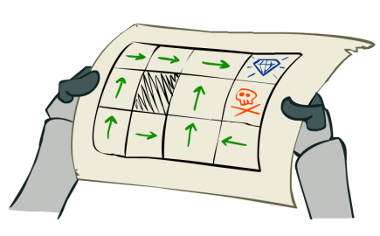
L7.1 Markov Decision Process
Zonghua Gu
Fall 2026
Acknowledgement: slides based on https://www.coursera.org/specializations/reinforcement-learning
And textbook by Sutton and Barto http://incompleteideas.net/book/the-book-2nd.html
Notes:
Reinforcement Learning Tutorial by javatpoint
https://www.javatpoint.com/reinforcement-learning

Slide 2
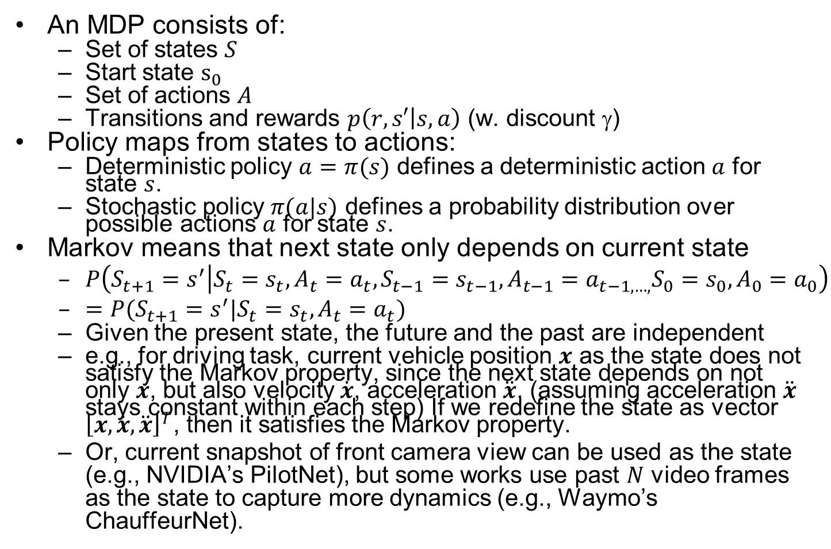
Markov Decision Process (MDP)
An MDP consists of:
  Set of states $S$
  Start state $s_{0}$
  Set of actions $A$
  Transitions and rewards $p\left(r,s′ | s,a\right)$ (w. discount $$)
Policy maps from states to actions:
  Deterministic policy $a=π(s)$ defines a deterministic action $a$ for state $s$.
  Stochastic policy $π(a|s)$ defines a probability distribution over possible actions $a$ for state $s$.
Markov means that next state only depends on current state
  $P\left(S_{t+1}=s^{′} | S_{t}=s_{t},A_{t}=a_{t},S_{t−1}=s_{t−1},A_{t−1}=a_{t−1,…,}S_{0}=s_{0},A_{0}=a_{0}\right)$
  $=P(S_{t+1}=s^{′}|S_{t}=s_{t},A_{t}=a_{t})$
  Given the present state, the future and the past are independent
  e.g., for driving task, current vehicle position $x$ as the state does not satisfy the Markov property, since the next state depends on not only $x$, but also velocity $\dot{x}$, acceleration $\ddot{x}$. (assuming acceleration $\ddot{x}$ stays constant within each step) If we redefine the state as vector ${\left[x,\dot{x}, \ddot{x}\right]}^{T}$, then it satisfies the Markov property.
  Or, current snapshot of front camera view can be used as the state (e.g., NVIDIA’s PilotNet), but some works use past $N$ video frames as the state to capture more dynamics (e.g., Waymo’s ChauffeurNet).
Notes:
Add utility slide, (like policy) Utility (Cumulative Reward) measured by Value function $V(s)$: sum of cumulative (discounted) rewards (utility) starting from state $s$ TODO 2 versions, optimal or policy
Q Value function $Q(s,a)$: sum of cumulative (discounted) rewards (utility) starting from state $s$ and taking action $a$.
v

Slide 3
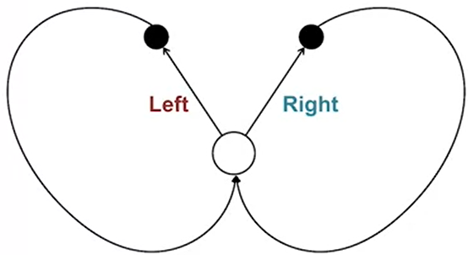
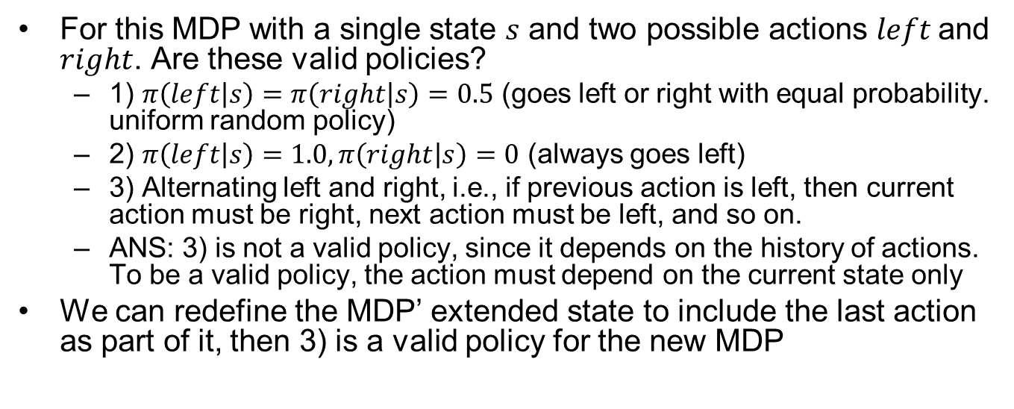



MDP Quiz
For this MDP with a single state $s$ and two possible actions $left$ and $right$. Are these valid policies?
  1) $π\left(left | s\right)=π\left(right | s\right)=0.5$ (goes left or right with equal probability. uniform random policy)
  2) $π\left(left | s\right)=1.0,π\left(right | s\right)=0$ (always goes left)
  3) Alternating left and right, i.e., if previous action is left, then current action must be right, next action must be left, and so on.
  ANS: 3) is not a valid policy, since it depends on the history of actions. To be a valid policy, the action must depend on the current state only
We can redefine the MDP’ extended state to include the last action as part of it, then 3) is a valid policy for the new MDP
$$(s, left)$$
$$(s, right)$$
$$s$$
Notes:
We can redefine the MDP’ extended state to include the last action as part of it, then 3) is a valid policy for the new MDP.

Slide 4
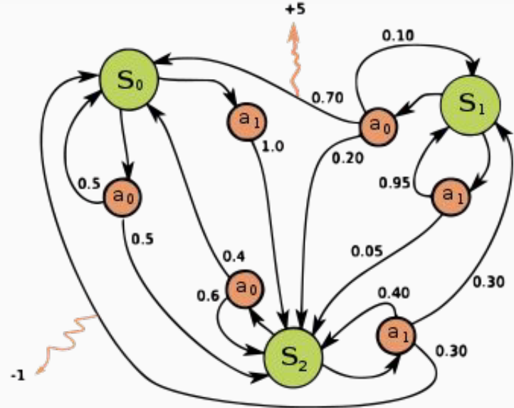
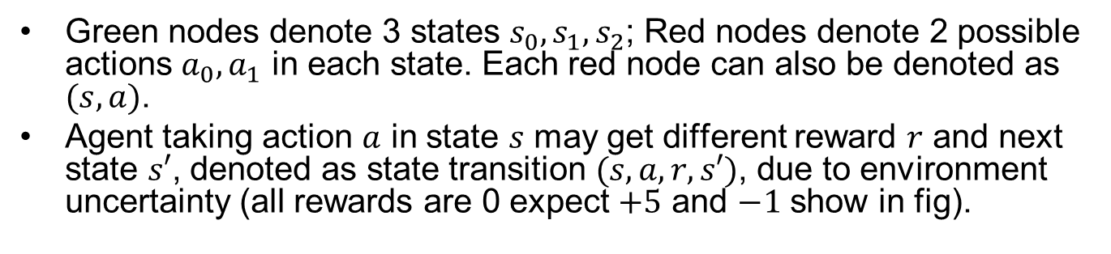
An Example MDP
Green nodes denote 3 states $s_{0},s_{1},s_{2}$; Red nodes denote 2 possible actions ${a_{0},a}_{1}$ in each state. Each red node can also be denoted as $(s,a)$.
Agent taking action $a$ in state $s$ may get different reward $r$ and next state $s′$, denoted as state transition $(s,a,r,s′)$, due to environment uncertainty (all rewards are 0 expect $+5$ and $−1$ show in fig).
Notes:
State transition $(s,a,r,s′)$ is atomic.

Slide 5
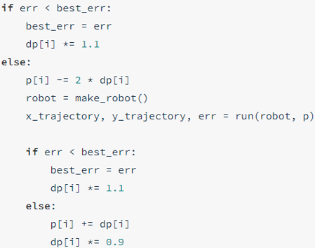
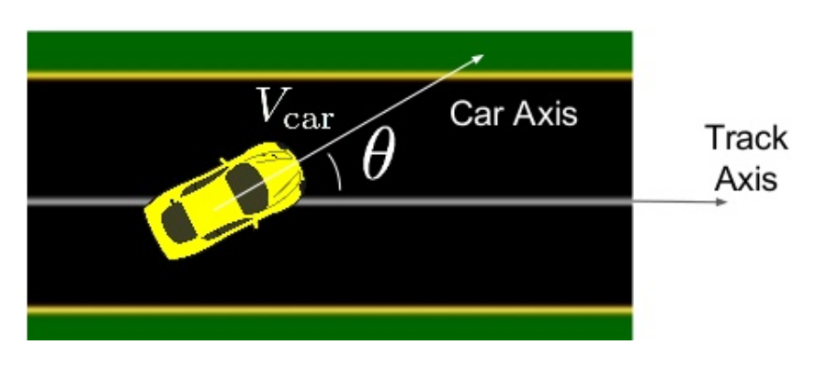
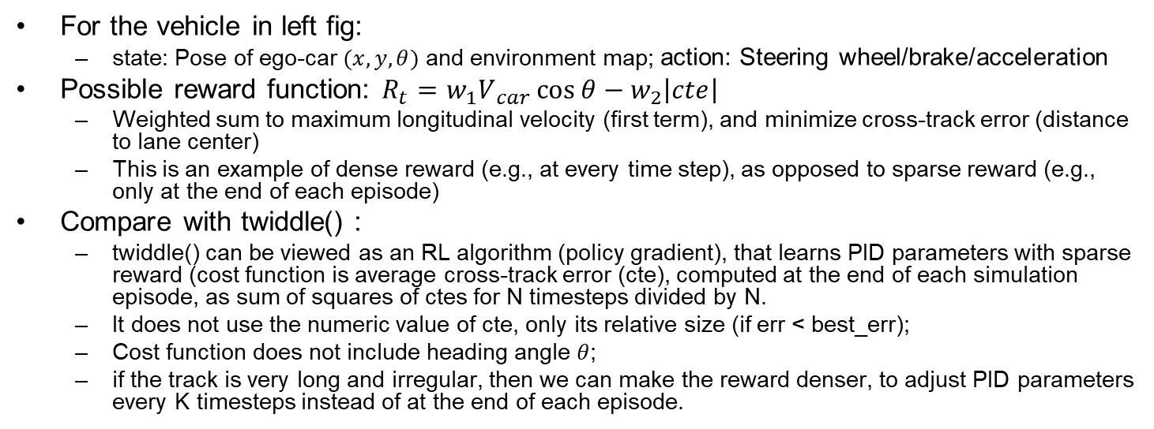
RL Reward Function
For the vehicle in left fig:
  state: Pose of ego-car $(x,y,θ)$ and environment map; action: Steering wheel/brake/acceleration
Possible reward function: $R_{t}​=w_{1}V​_{car}\cos{θ}−​w_{2}\left|cte\right|​$
  Weighted sum to maximum longitudinal velocity (first term), and minimize cross-track error (distance to lane center)
  This is an example of dense reward (e.g., at every time step), as opposed to sparse reward (e.g., only at the end of each episode)
Compare with twiddle() :
  twiddle() can be viewed as an RL algorithm (policy gradient), that learns PID parameters with sparse reward (cost function is average cross-track error (cte), computed at the end of each simulation episode, as sum of squares of ctes for N timesteps divided by N.
  It does not use the numeric value of cte, only its relative size (if err < best_err);
  Cost function does not include heading angle $θ$;
  if the track is very long and irregular, then we can make the reward denser, to adjust PID parameters every K timesteps instead of at the end of each episode.
twiddle()
Ben Lau, Quantitative Researcher, Hobbyist, at MLconf NYC 2017
Notes:
PID controller is used to track a fixed circular path
Intuitive reward function: $R_{t}=V_{car}\cos{θ}$
maximum longitudinal velocity
Sometimes need to do “reward function hacking” to find one that works well, e.g., $R_{t}​=V​_{car}\cos{θ}−V_{car}​​​sin⁡θ−V​_{car}​\left|cte\right|​$
$$V_{car}​​​sin⁡θ$$

Slide 6
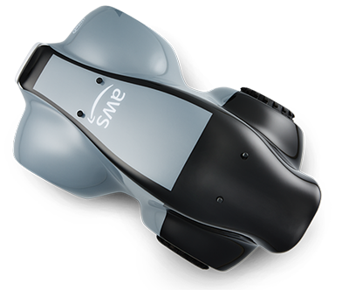
Amazon DeepRacer
Amazon Web Services (AWS) launched DeepRacer in 2018 for training AD algorithms with RL
  https://aws.amazon.com/deepracer/
You can train RL algorithm in the simulator on AWS cloud, but it costs money after some free time.
They hold competitions, both online and in real-world. 1/10th scale race car costs USD $349.

Slide 7
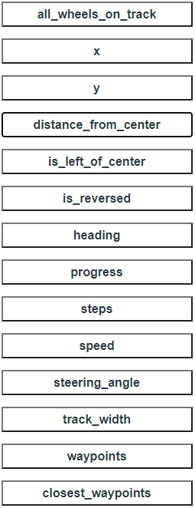
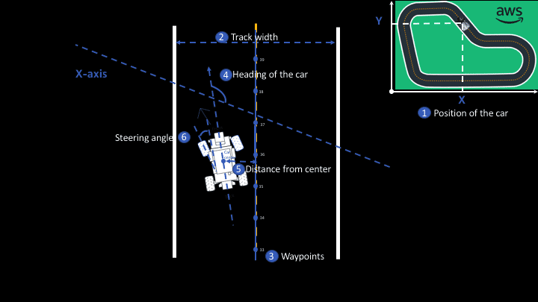
Params for Writing Reward Function
Notes:
Writing a Reward Function

Slide 8
Example Reward Function
def reward_function(params):
'''Example of penalize steering, which helps mitigate zig-zag behaviors'''
# Read input parameters
distance_from_center = params['distance_from_center']
track_width = params['track_width']
steering = abs(params['steering_angle']) # Only need the absolute steering angle
# Calculate 3 markers that are at varying distances away from the center line
marker_1 = 0.1 * track_width
marker_2 = 0.25 * track_width
marker_3 = 0.5 * track_width
# Give higher reward if the agent is closer to center line and vice versa
if distance_from_center <= marker_1:
reward = 1
elif distance_from_center <= marker_2:
reward = 0.5
elif distance_from_center <= marker_3:
reward = 0.1
else:
reward = 1e-3 # likely crashed/ close to off track
# Steering penalty threshold, change the number based on your action space setting
ABS_STEERING_THRESHOLD = 15
# Penalize reward if the agent is steering too much
if steering > ABS_STEERING_THRESHOLD:
reward *= 0.8
return float(reward)
A more realistic and complex reward function: https://www.middleware-solutions.fr/2019/08/14/an-introduction-to-aws-deepracer

Slide 9
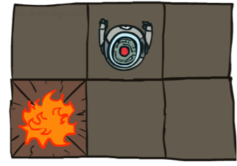
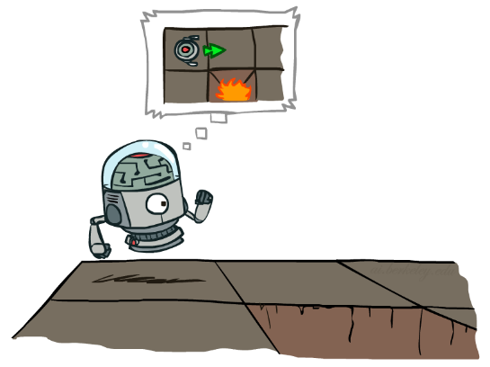

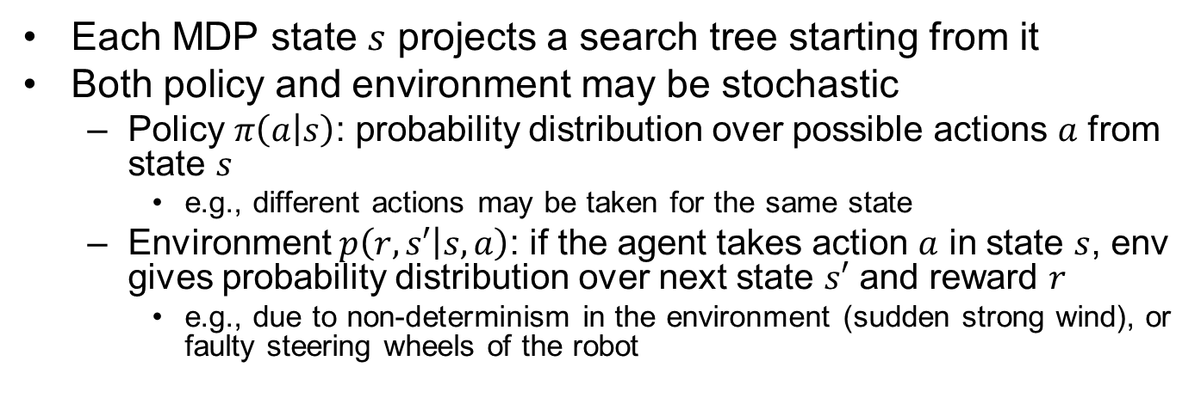
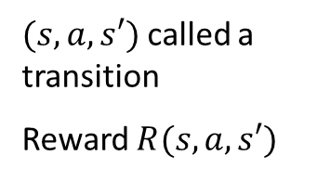
MDP Search Tree
Each MDP state $s$ projects a search tree starting from it
Both policy and environment may be stochastic
  Policy $π\left(a | s\right)$: probability distribution over possible actions $a$ from state $s$
    e.g., different actions may be taken for the same state
  Environment $p\left(r,s′ | s,a\right)$: if the agent takes action $a$ in state $s$, env gives probability distribution over next state $s′$ and reward $r$
    e.g., due to non-determinism in the environment (sudden strong wind), or faulty steering wheels of the robot
s
s is a state
a
(s, a) is a q-state
s, a
$(s,a,s′)$ called a transition
Reward $R(s,a,s′)$
s,a,s’
s’
Notes:
In MDP chance node represents uncertainty about what might happen based on (s,a) [as opposed to being a random adversary]
$$T(s,a,s’)$$
Q-state (s,a) is when you were in a state and took an action
Best average, long term reward
Expectimax, but no real terminal node.
Does not have min-nodes
State node vs q state nodes

Slide 10
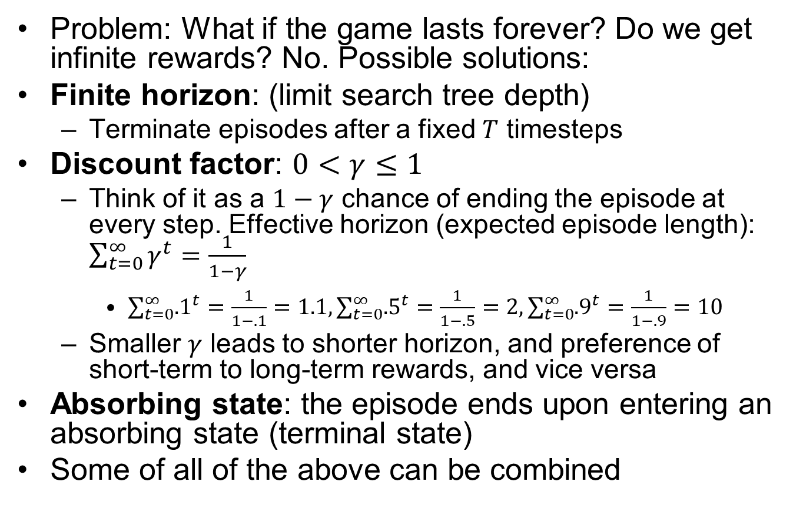
Preventing Infinite Rewards
Problem: What if the game lasts forever? Do we get infinite rewards? No. Possible solutions:
Finite horizon: (limit search tree depth)
  Terminate episodes after a fixed $T$ timesteps
Discount factor: $0<γ≤1$
  Think of it as a $1−γ$ chance of ending the episode at every step. Effective horizon (expected episode length): $\sum_{t=0}^{∞}{γ^{t}}=\frac{1}{1−γ}$
    $\sum_{t=0}^{∞}{{.1}^{t}}=\frac{1}{1−.1}=1.1,\sum_{t=0}^{∞}{{.5}^{t}}=\frac{1}{1−.5}=2,\sum_{t=0}^{∞}{{.9}^{t}}=\frac{1}{1−.9}=10$
  Smaller $γ$ leads to shorter horizon, and preference of short-term to long-term rewards, and vice versa
Absorbing state: the episode ends upon entering an absorbing state (terminal state)
Some of all of the above can be combined
Notes:
$U\left(\left[r_{0},…,r_{∞}\right]\right)=\sum_{t=0}^{∞}{γ^{t}r_{t}}≤\sum_{t=0}^{∞}{γ^{t}r_{max}}=\frac{r_{max}}{1−γ}$ Absorbing state: guarantee that for every policy, a terminal state will eventually be reached

Slide 11


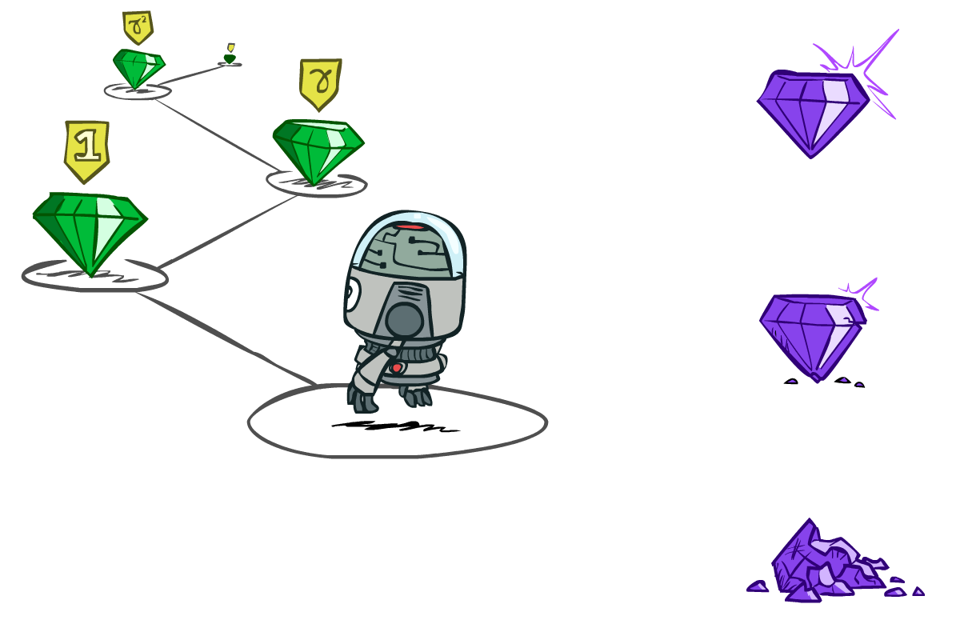

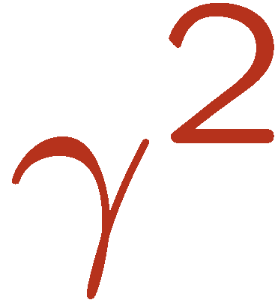
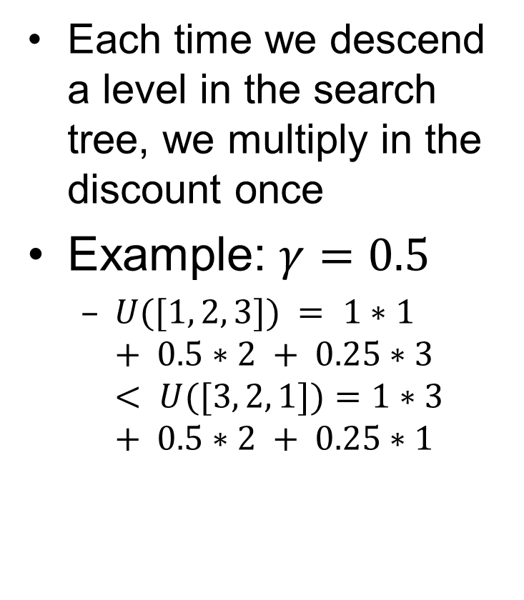
Discount Factor Example
Each time we descend a level in the search tree, we multiply in the discount once
Example: $γ=0.5$
  $U([1, 2, 3]) = 1∗1 + 0.5∗2 + 0.25∗3 < U([3, 2, 1])=1∗3 + 0.5∗2 + 0.25∗1$
Notes:
Rewards in the future (deeper in the tree) matter less
Interesting: running expectimax, if having to truncate the search, then not losing much; e.g., less then \gamma^d / (1-\gamma)
Augment q states with another option: instant death!
Repeated loop, difference from search, is a win. Distinction of visiting a state.
Do the example.

Slide 12



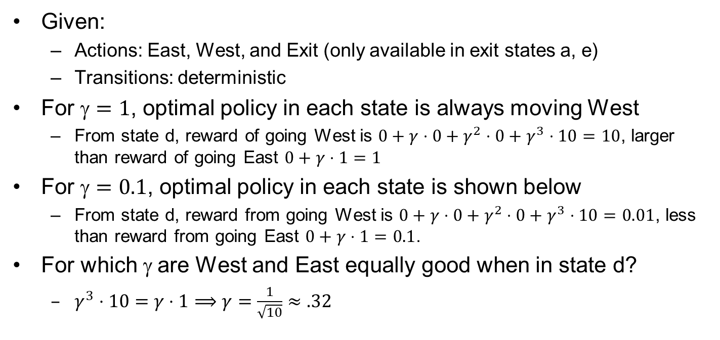











Discounting Example
Given:
  Actions: East, West, and Exit (only available in exit states a, e)
  Transitions: deterministic
For $=1$, optimal policy in each state is always moving West
  From state d, reward of going West is $0+γ⋅0+{γ^{2}⋅0+γ}^{3}⋅10=10$, larger than reward of going East $0+γ⋅1=1$
For $=0.1$, optimal policy in each state is shown below
  From state d, reward from going West is $0+γ⋅0+γ^{2}⋅0+γ^{3}⋅10=0.01$, less than reward from going East $0+γ⋅1=0.1$.
For which $$ are West and East equally good when in state d?
  $γ^{3}⋅10=γ⋅1⟹γ=\frac{1}{\sqrt{10}}≈.32$
$$←$$
$$←$$
$$←$$
$$←$$
$$←$$
$$→$$
$$←$$
$$←$$
$$←$$
$$→$$
$=1$
$=0.1$
$=\frac{1}{\sqrt{10}}$

Slide 13
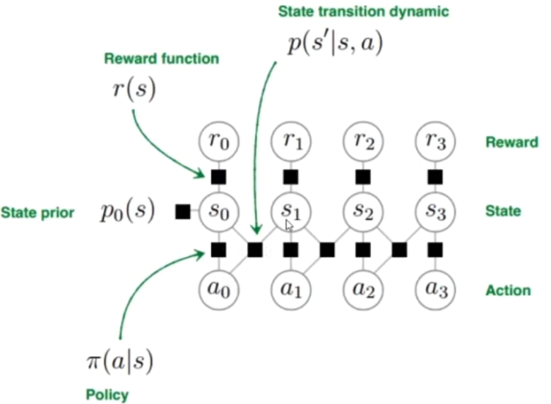
Known MDP
In this lecture, we assume known MDP, and use dynamic programming to solve Bellman Equations and find the optimal policy (no learning here).
known
known
want to optimize
Notes:
https://www.bilibili.com/video/BV1hg4y1873j?from=search&seid=14821159815301028409

Slide 14

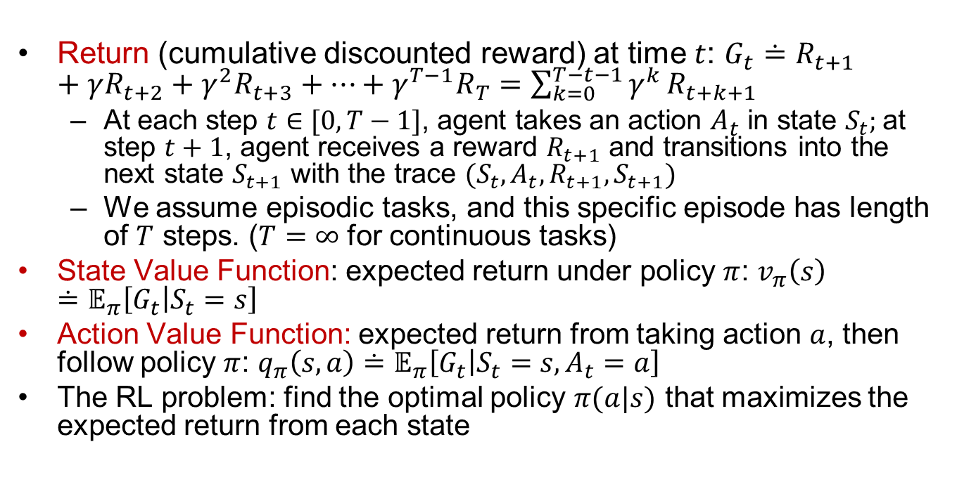


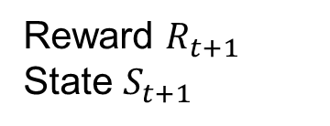
Formal Definition of MDP
Important
Return (cumulative discounted reward) at time $t$: $G_{t}≐R_{t+1}+γR_{t+2}+γ^{2}R_{t+3}+…+γ^{T−1}R_{T}=\sum_{k=0}^{T−t−1}{γ^{k}}R_{t+k+1}$
  At each step $t∈[0,T−1]$, agent takes an action $A_{t}$ in state $S_{t}$; at step $t+1$, agent receives a reward $R_{t+1}$ and transitions into the next state $S_{t+1}$ with the trace $(S_{t}, A_{t}, R_{t+1}, S_{t+1})$
  We assume episodic tasks, and this specific episode has length of $T$ steps. ($T=∞$ for continuous tasks)
State Value Function: expected return under policy $π$: $v_{π}\left(s\right)≐𝔼_{π}\left[G_{t} | S_{t}=s\right]$
Action Value Function: expected return from taking action $a$, then follow policy $π$: $q_{π}\left(s,a\right)≐𝔼_{π}\left[G_{t} | S_{t}=s,A_{t}=a\right]$
The RL problem: find the optimal policy $π(a|s)$ that maximizes the expected return from each state
$${p(R_{t+1}, S}_{t+1}|S_{t},A_{t})$$
Environment
Action $A_{t}$
Reward $R_{t+1}$
State $S_{t+1}$
RL Agent
$$π(A_{t}|S_{t})$$

Slide 15
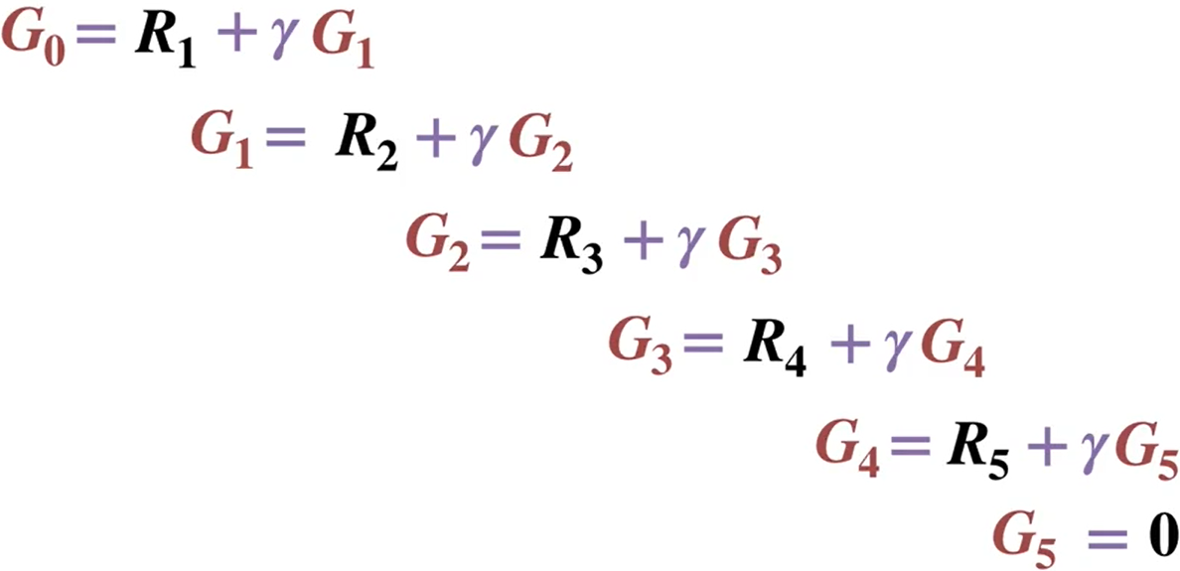
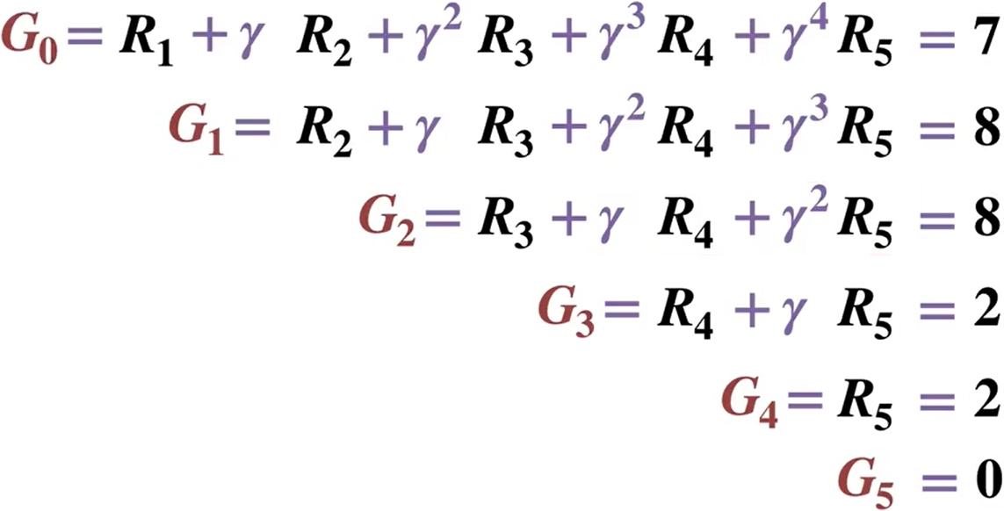
Example: Computing Returns for One Episode
Important
Working backward is more efficient than working forward as it avoids redundant computations.
$$R_{1}$$
$$R_{2}$$
$$R_{3}$$
$$R_{4}$$
$$R_{5}$$
Reward $R_{t+1}$
Step $t$
0
1
2
3
4
5

Slide 16
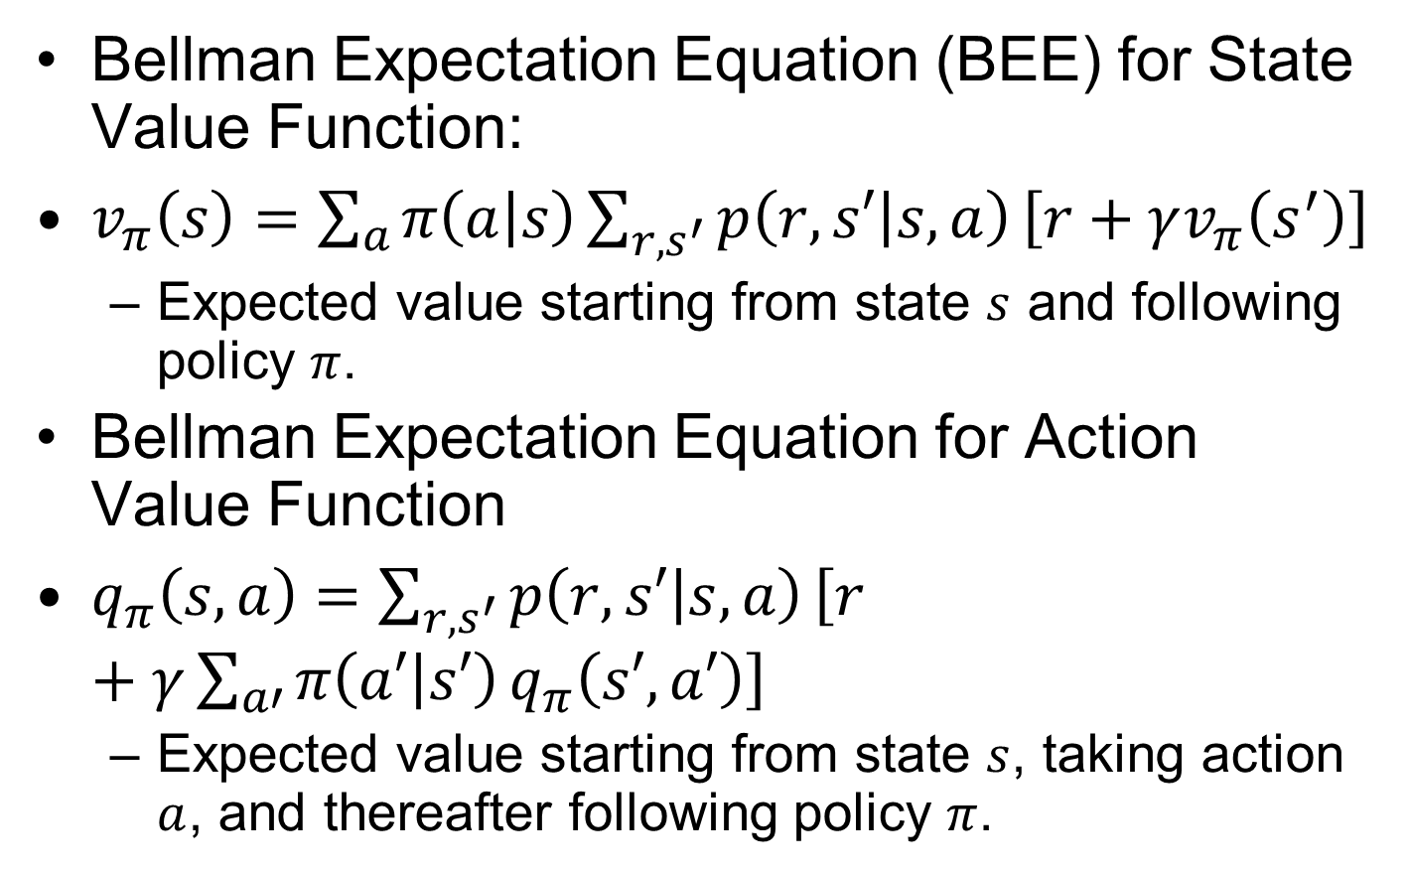
Bellman Expectation Equations
Important
Bellman Expectation Equation (BEE) for State Value Function:
$v_{π}\left(s\right)=\sum_{a}{π\left(a | s\right)}\sum_{r,s^{′}}{p\left(r,s′ | s,a\right)}\left[r+γv_{π}\left(s^{′}\right)\right]$
  Expected value starting from state $s$ and following policy $π$.
Bellman Expectation Equation for Action Value Function
$q_{π}\left(s,a\right)=\sum_{r,s^{′}}{p\left(r,s′ | s,a\right)}\left[r+γ\sum_{a′}{π\left(a′ | s′\right)}q_{π}\left(s′,a′\right)\right]$
  Expected value starting from state $s$, taking action $a$, and thereafter following policy $π$.
Notes:
$=𝔼_{π}[R_{t+1}+γv_{π}(S_{t+1})|S_{t}=s]$ $=𝔼_{π}[R_{t+1}+γv_{π}(S_{t+1})|S_{t}=s, A_{t}=a]$

Slide 17
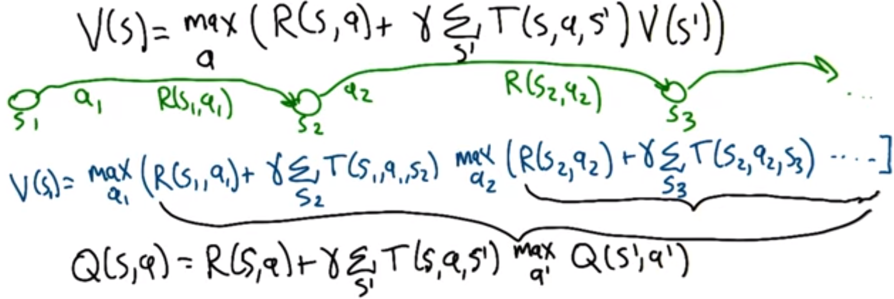
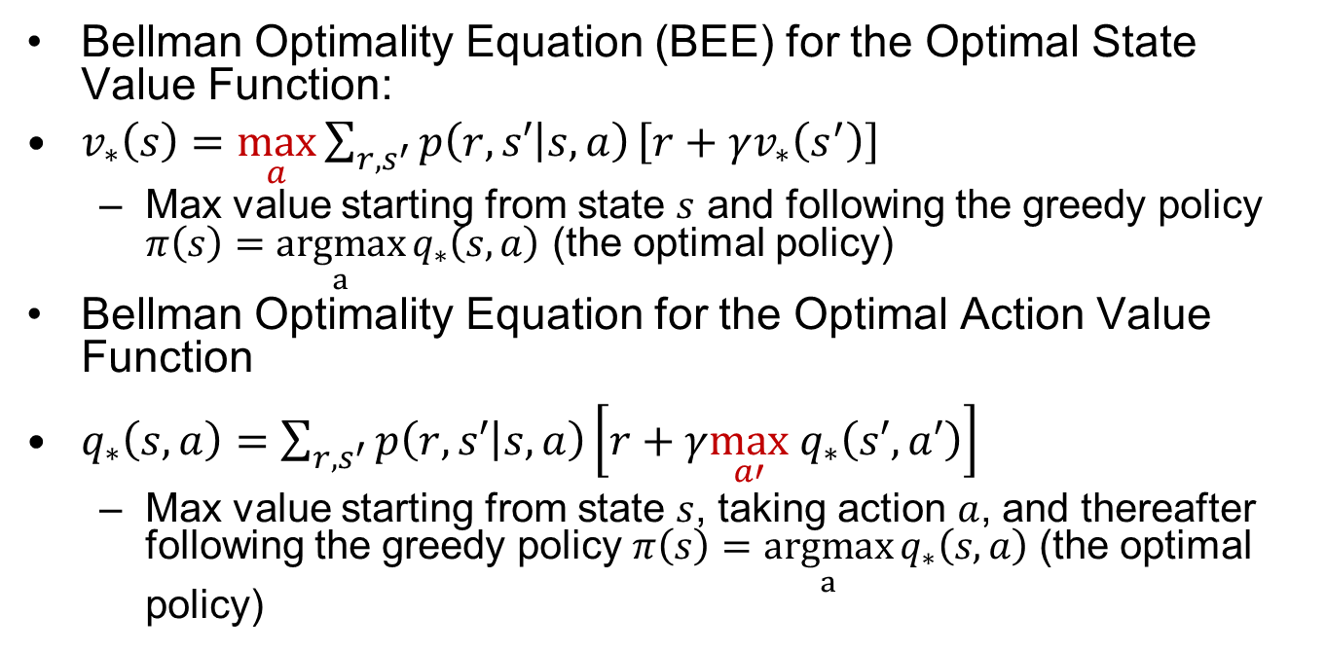
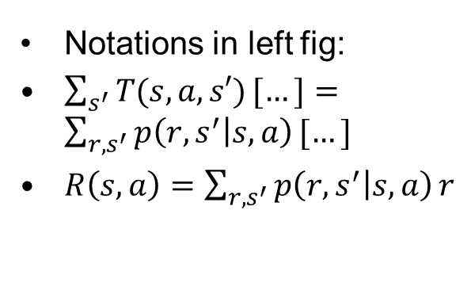
Bellman Optimality Equations
Important
Bellman Optimality Equation (BEE) for the Optimal State Value Function:
$v_{∗}\left(s\right)=$ $\max_{a}{\sum_{r,s^{′}}{p\left(r,s′ | s,a\right)}\left[r+γv_{∗}\left(s^{′}\right)\right]}$
  Max value starting from state $s$ and following the greedy policy $π\left(s\right)=$ $\underset{a}{argmax}{q_{∗}\left(s,a\right)}$ (the optimal policy)
Bellman Optimality Equation for the Optimal Action Value Function
$q_{∗}\left(s,a\right)=\sum_{r,s^{′}}{p\left(r,s′ | s,a\right)}\left[r+γ\max_{a′} q_{∗}\left(s′,a′\right)\right]$
  Max value starting from state $s$, taking action $a$, and thereafter following the greedy policy $π\left(s\right)=$ $\underset{a}{argmax}{q_{∗}\left(s,a\right)}$ (the optimal policy)
Notations in left fig:
$\sum_{s^{′}}{T(s,a,s′)}[…]=\sum_{r,s^{′}}{p\left(r,s^{′} | s,a\right)}[…]$
$R\left(s,a\right)=\sum_{r,s^{′}}{p\left(r,s^{′} | s,a\right)}r$
Notes:
$$v_{∗}\left(s\right)=\max_{a} q_{∗}\left(s,a\right);q_{∗}\left(s,a\right)=\sum_{r,s^{′}}{p\left(r,s′ | s,a\right)}\left[r+γv_{∗}\left(s′\right)\right]$$
$$q_{∗}\left(C,l\right)=\sum_{r,s^{′}}{p\left(r,s′ | s,a\right)}\left[r+γv_{∗}\left(s′\right)\right]$$

Slide 18
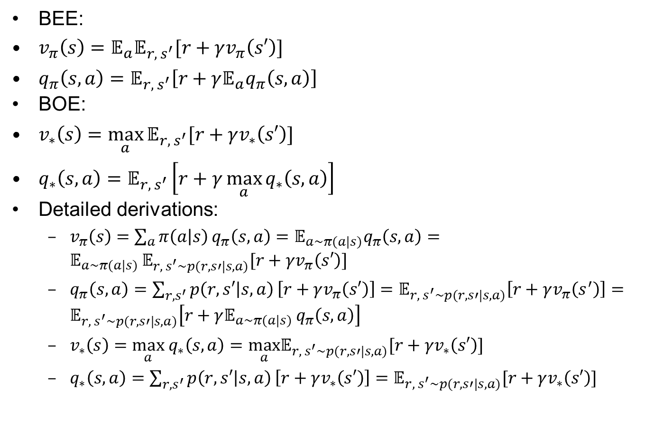
Bellman Equations written with Expectation Symbols
BEE:
$v_{π}\left(s\right)=𝔼_{a}𝔼_{r, s^{′}}[r+γv_{π}\left(s′\right)]$
$q_{π}\left(s,a\right)=𝔼_{r, s^{′}}\left[r+γ𝔼_{a}q_{π}\left(s,a\right)\right]$
BOE:
$v_{∗}\left(s\right)=\max_{a}{𝔼_{r, s^{′}}[r+γv_{∗}\left(s′\right)]}$
$q_{∗}\left(s,a\right)=𝔼_{r, s^{′}}\left[r+γ\max_{a}{q_{∗}\left(s,a\right)}\right]$
Detailed derivations:
  $v_{π}\left(s\right)=\sum_{a}{π\left(a | s\right)}q_{π}\left(s,a\right)=𝔼_{a∼π(a|s)}q_{π}\left(s,a\right)=𝔼_{a∼π(a|s) }𝔼_{r, s^{′}∼p(r,s′|s,a)}[r+γv_{π}\left(s′\right)]$
  $q_{π}\left(s,a\right)=\sum_{r,s^{′}}{p\left(r,s′ | s,a\right)}\left[r+γv_{π}\left(s′\right)\right]=𝔼_{r, s^{′}∼p(r,s′|s,a)}\left[r+γv_{π}\left(s^{′}\right)\right]=𝔼_{r, s^{′}∼p(r,s′|s,a)}\left[r+γ𝔼_{a∼π(a|s) }q_{π}\left(s,a\right)\right]$
  $v_{∗}\left(s\right)=\max_{a} q_{∗}\left(s,a\right)=\max_{a}𝔼_{r, s^{′}∼p(r,s′|s,a)}[r+γv_{∗}\left(s′\right)]$
  $q_{∗}\left(s,a\right)=\sum_{r,s^{′}}{p\left(r,s′ | s,a\right)}\left[r+γv_{∗}\left(s′\right)\right]=𝔼_{r, s^{′}∼p(r,s′|s,a)}[r+γv_{∗}\left(s′\right)]$

Slide 19


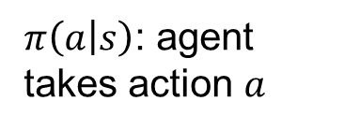






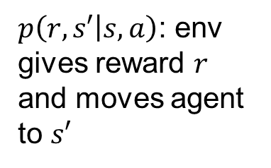
Backup Diagrams
Important
$π\left(a | s\right)$: agent takes action $a$
Agent chooses an action $a$
(state, action)
$p\left(r,s′ | s,a\right)$: env gives reward $r$ and moves agent to $s′$
max
Env chooses the next state $s′$
state
Bellman Exp Eqn for $v_{π}\left(s\right)$
Bellman Opt Eqn for $v_{∗}\left(s\right)$
$$p\left(r,s′ | s,a\right)$$
$$π\left(a | s\right)$$
max
max
Bellman Exp Eqn for $q_{π}\left(s,a\right)$
Bellman Opt Eqn for $q_{∗}\left(s,a\right)$

Slide 20
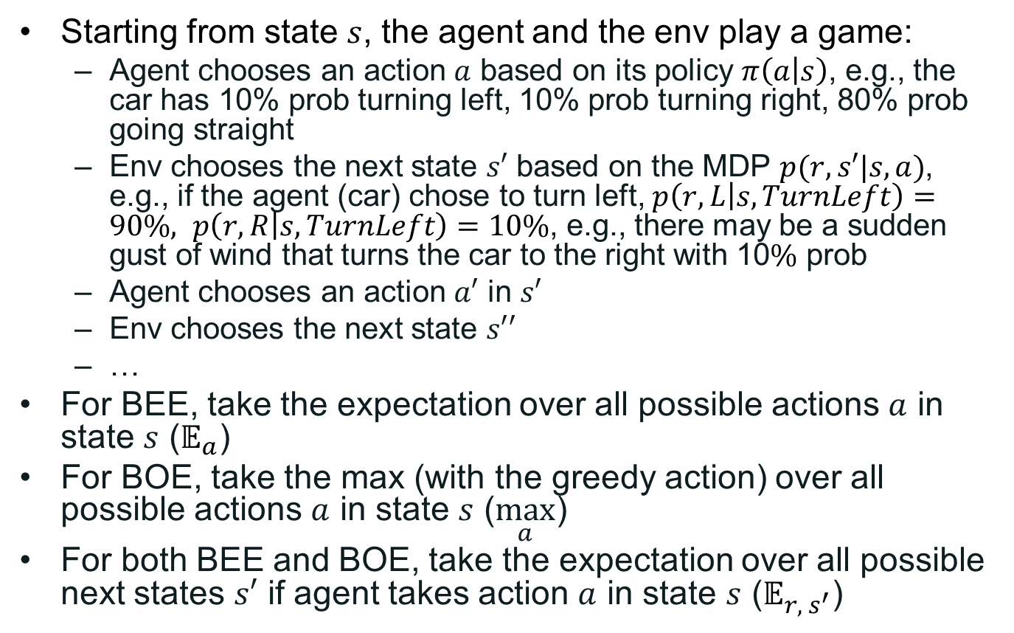
Further Explanations
Starting from state $s$, the agent and the env play a game:
  Agent chooses an action $a$ based on its policy $π\left(a | s\right)$, e.g., the car has 10% prob turning left, 10% prob turning right, 80% prob going straight
  Env chooses the next state $s′$ based on the MDP $p(r,s′|s,a)$, e.g., if the agent (car) chose to turn left, $p\left(r,L | s,TurnLeft\right)=90\%, p\left(r,R | s,TurnLeft\right)=10\%$, e.g., there may be a sudden gust of wind that turns the car to the right with 10$\%$ prob
  Agent chooses an action $a′$ in $s′$
  Env chooses the next state $s′′$
  …
For BEE, take the expectation over all possible actions $a$ in state $s$ ($𝔼_{a}$)
For BOE, take the max (with the greedy action) over all possible actions $a$ in state $s$ ($\max_{a}$)
For both BEE and BOE, take the expectation over all possible next states $s′$ if agent takes action $a$ in state $s$ ($𝔼_{r, s^{′}}$)

Slide 21

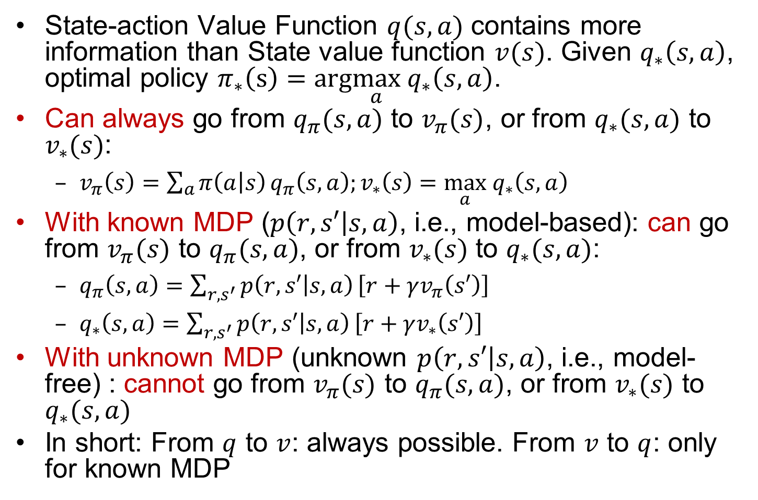
$v(s)$ vs. $q(s,a)$
State-action Value Function $q(s,a)$ contains more information than State value function $v(s)$. Given $q_{∗}\left(s,a\right)$, optimal policy $π_{∗}\left(s\right)=arg\max_{a} q_{∗}\left(s,a\right)$.
Can always go from $q_{π}(s,a)$ to $v_{π}(s)$, or from $q_{∗}(s,a)$ to $v_{∗}(s)$:
  $v_{π}\left(s\right)=\sum_{a}{π\left(a | s\right)}q_{π}\left(s,a\right);v_{∗}\left(s\right)=\max_{a} q_{∗}\left(s,a\right)$
With known MDP ($p\left(r,s′ | s,a\right)$, i.e., model-based): can go from $v_{π}(s)$ to $q_{π}(s,a)$, or from $v_{∗}(s)$ to $q_{∗}(s,a)$:
  $q_{π}\left(s,a\right)=\sum_{r,s^{′}}{p\left(r,s′ | s,a\right)}\left[r+γv_{π}\left(s′\right)\right]$
  $q_{∗}\left(s,a\right)=\sum_{{r,s}^{′}}{p\left(r,s′ | s,a\right)}\left[r+γv_{∗}\left(s′\right)\right]$
With unknown MDP (unknown $p\left(r,s′ | s,a\right)$, i.e., model-free) : cannot go from $v_{π}(s)$ to $q_{π}(s,a)$, or from $v_{∗}(s)$ to $q_{∗}(s,a)$
In short: From $q$ to $v$: always possible. From $v$ to $q$: only for known MDP
Notes:
From v to q: always possible. From q to v: only for known MDP.
Can get optimal policy $π_{∗}\left(s\right)=arg\max_{a} q_{∗}\left(s,a\right)$
Cannot get optimal policy $π_{∗}\left(s\right)$ from $v_{∗}\left(s\right)$

Slide 22
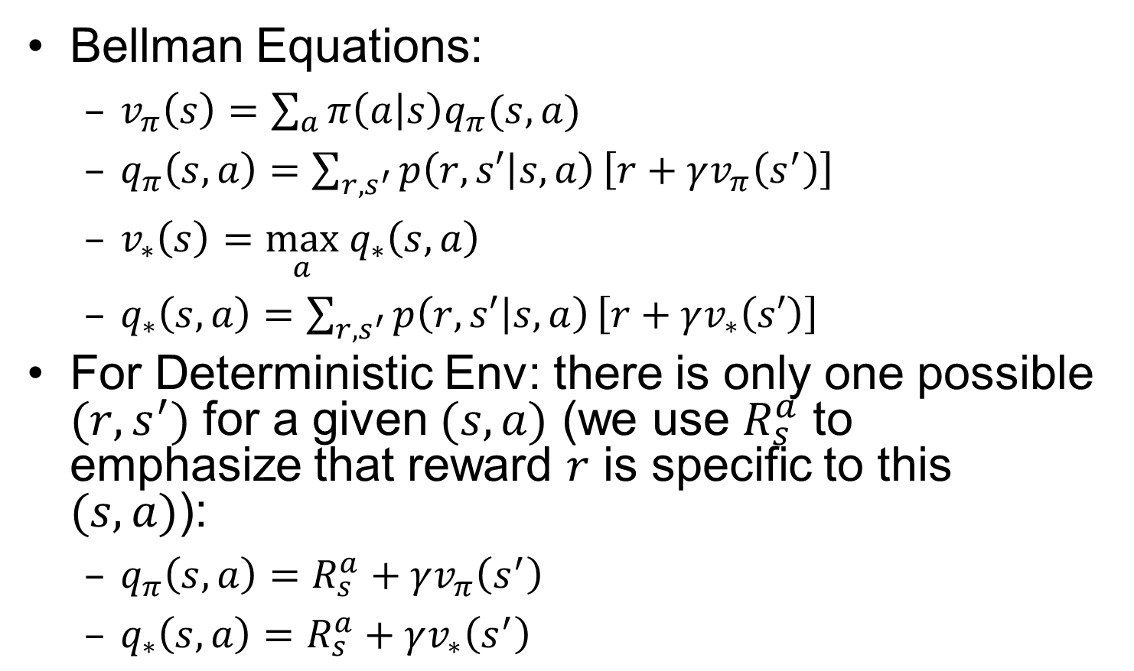
Simplified Bellman Equations for Deterministic Env
Bellman Equations:
  $v_{π}\left(s\right)=\sum_{a}{π\left(a | s\right)q_{π}(s,a)}$
  $q_{π}\left(s,a\right)=\sum_{{r, s}^{′}}{p\left(r,s′ | s,a\right)}\left[r+γv_{π}\left(s^{′}\right)\right]$
  $v_{∗}\left(s\right)=\max_{a} q_{∗}\left(s,a\right)$
  $q_{∗}\left(s,a\right)=\sum_{{r, s}^{′}}{p\left(r,s′ | s,a\right)}\left[r+γv_{∗}\left(s′\right)\right]$
For Deterministic Env: there is only one possible $(r,s^{′})$ for a given $(s,a)$ (we use $R_{s}^{a}$ to emphasize that reward $r$ is specific to this $(s,a)$):
  $q_{π}\left(s,a\right)=R_{s}^{a}+γv_{π}\left(s^{′}\right)$
  $q_{∗}\left(s,a\right)=R_{s}^{a}+γv_{∗}\left(s^{′}\right)$

Slide 23
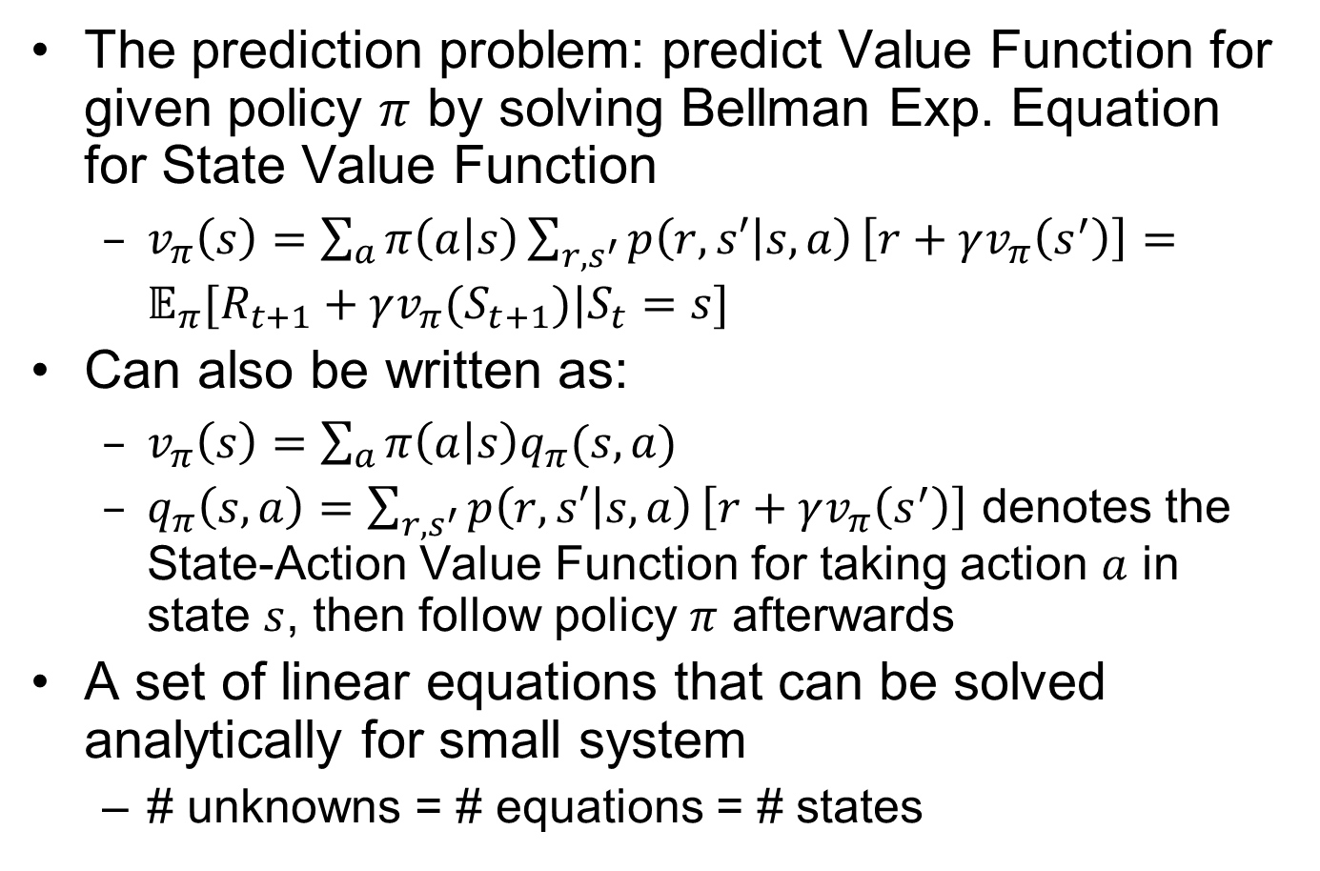
Policy Evaluation
The prediction problem: predict Value Function for given policy $π$ by solving Bellman Exp. Equation for State Value Function
  $v_{π}\left(s\right)=\sum_{a}{π\left(a | s\right)}\sum_{{r,s}^{′}}{p\left(r,s′ | s,a\right)}\left[r+γv_{π}\left(s^{′}\right)\right]=𝔼_{π}[R_{t+1}+γv_{π}(S_{t+1})|S_{t}=s]$
Can also be written as:
  $v_{π}\left(s\right)=\sum_{a}{π\left(a | s\right)q_{π}(s,a)}$
  $q_{π}\left(s,a\right)=\sum_{{r, s}^{′}}{p\left(r,s′ | s,a\right)}\left[r+γv_{π}\left(s^{′}\right)\right]$ denotes the State-Action Value Function for taking action $a$ in state $s$, then follow policy $π$ afterwards
A set of linear equations that can be solved analytically for small system
  # unknowns = # equations = # states
Notes:
Turn recursive Bellman equations into updates
(like value iteration)
Computationally efficient:
Without the max operator, the Bellman equations are just
$$V_{0}^{π}\left(s\right)=0$$
$$V_{k+1}^{π}\left(s\right)=\sum_{s′}{T\left(s,π(s),s^{′}\right)}[R(s,π(s),s^{′})+γV_{k}(s′)]$$

Slide 24
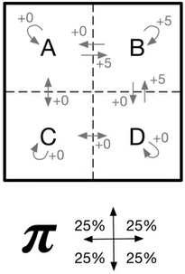
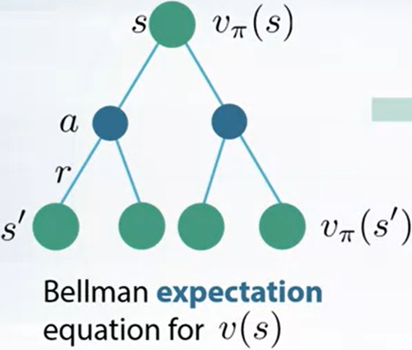
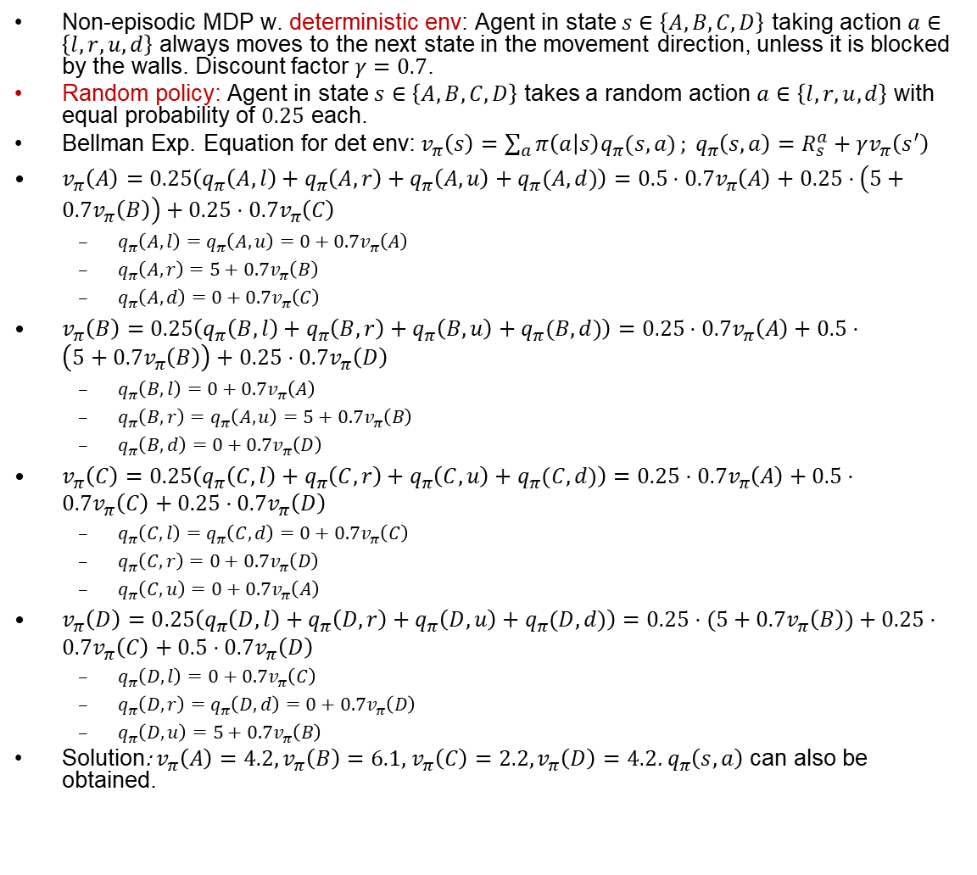
Grid World1: Policy Evaluation
Non-episodic MDP w. deterministic env: Agent in state $s∈\left\{A,B,C,D\right\}$ taking action $a∈\left\{l,r,u,d\right\}$ always moves to the next state in the movement direction, unless it is blocked by the walls. Discount factor $γ=0.7$.
Random policy: Agent in state $s∈\left\{A,B,C,D\right\}$ takes a random action $a∈\left\{l,r,u,d\right\}$ with equal probability of $0.25$ each.
Bellman Exp. Equation for det env:$v_{π}\left(s\right)=\sum_{a}{π\left(a | s\right)q_{π}(s,a)}; q_{π}\left(s,a\right)=R_{s}^{a}+γv_{π}\left(s^{′}\right)$
$v_{π}\left(A\right)=0.25\left(q_{π}\left(A,l\right)+q_{π}\left(A,r\right)+q_{π}\left(A,u\right)+q_{π}(A,d)\right)=0.5⋅0.7v_{π}\left(A\right)+0.25⋅\left(5+0.7v_{π}\left(B\right)\right)+0.25⋅0.7v_{π}\left(C\right)$
  $q_{π}\left(A,l\right)=q_{π}\left(A,u\right)=0+0.7v_{π}\left(A\right)$
  $q_{π}\left(A,r\right)=5+0.7v_{π}\left(B\right)$
  $q_{π}\left(A,d\right)=0+0.7v_{π}\left(C\right)$
$v_{π}\left(B\right)=0.25\left(q_{π}\left(B,l\right)+q_{π}\left(B,r\right)+q_{π}\left(B,u\right)+q_{π}(B,d)\right)=0.25⋅0.7v_{π}\left(A\right)+0.5⋅\left(5+0.7v_{π}\left(B\right)\right)+0.25⋅0.7v_{π}\left(D\right)$
  $q_{π}\left(B,l\right)=0+0.7v_{π}\left(A\right)$
  $q_{π}\left(B,r\right)=q_{π}\left(A,u\right)=5+0.7v_{π}\left(B\right)$
  $q_{π}\left(B,d\right)=0+0.7v_{π}\left(D\right)$
$v_{π}\left(C\right)=0.25\left(q_{π}\left(C,l\right)+q_{π}\left(C,r\right)+q_{π}\left(C,u\right)+q_{π}(C,d)\right)=0.25⋅0.7v_{π}\left(A\right)+0.5⋅0.7v_{π}\left(C\right)+0.25⋅0.7v_{π}\left(D\right)$
  $q_{π}\left(C,l\right)=q_{π}\left(C,d\right)=0+0.7v_{π}\left(C\right)$
  $q_{π}\left(C,r\right)=0+0.7v_{π}\left(D\right)$
  $q_{π}\left(C,u\right)=0+0.7v_{π}\left(A\right)$
$v_{π}\left(D\right)=0.25\left(q_{π}\left(D,l\right)+q_{π}\left(D,r\right)+q_{π}\left(D,u\right)+q_{π}(D,d)\right)=0.25⋅(5+0.7v_{π}\left(B\right))+0.25⋅0.7v_{π}\left(C\right)+0.5⋅0.7v_{π}\left(D\right)$
  $q_{π}\left(D,l\right)=0+0.7v_{π}\left(C\right)$
  $q_{π}\left(D,r\right)=q_{π}\left(D,d\right)=0+0.7v_{π}\left(D\right)$
  $q_{π}\left(D,u\right)=5+0.7v_{π}\left(B\right)$
Solution: $v_{π}\left(A\right)=4.2,v_{π}\left(B\right)=6.1,$ $v_{π}\left(C\right)=2.2,v_{π}\left(D\right)=4.2$. $q_{π}\left(s,a\right)$ can also be obtained.
BF=4
BF=1
(BF: Branching Factor)
Notes:
In the back diagrams, BF denotes Branching Factor of backup diagram.

